Slide 1


Part 3: Docker File Deeper

Slide 2
What We Will Cover
Filename Convention
Image Layers
Docker File Syntax
Base Image
Environment Setup
Comments
Installing Dependencies
Copying Files
Build Context
Ignoring Files
Environment Variables
Exposing Ports
Executing Commands
Building & Running

Slide 3
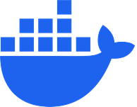
Getting Started

Slide 4
So, You Have an App…
from flask import Flask
app = Flask(__name__)
@app.route("/")
def hello():
return "Hello World!"
if __name__ == "__main__":
app.run(debug=True)
Notes:
https://docs.docker.com/build/concepts/dockerfile/#example
from flask import Flask
app = Flask(__name__)
@app.route("/")
def hello():
return "Hello World!"
if __name__ == "__main__":
app.run(debug=True)

Slide 5
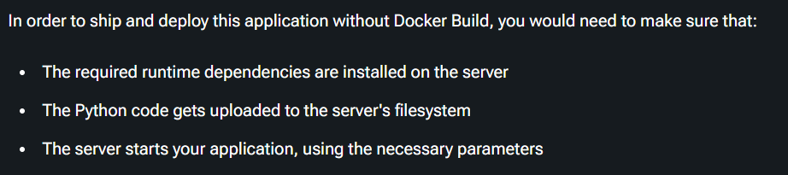
Notes:
https://docs.docker.com/build/concepts/dockerfile/#example

Slide 6
Docker to the Rescue!
# syntax=docker/dockerfile:1
FROM ubuntu:22.04
# install app dependencies
RUN apt-get update && apt-get install -y python3 python3-pip
RUN pip install flask==3.0.*
# install app
COPY hello.py /
# final configuration
ENV FLASK_APP=hello
EXPOSE 8000
CMD ["flask", "run", "--host", "0.0.0.0", "--port", "8000"]

Slide 7
Filename Convention

Slide 8
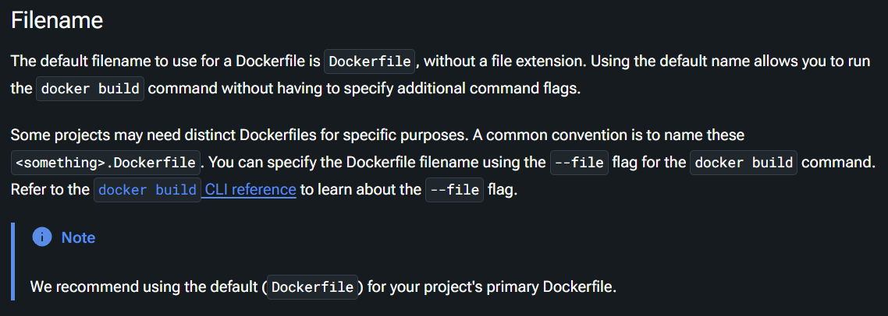
Notes:
https://docs.docker.com/build/concepts/dockerfile/#filename

Slide 9
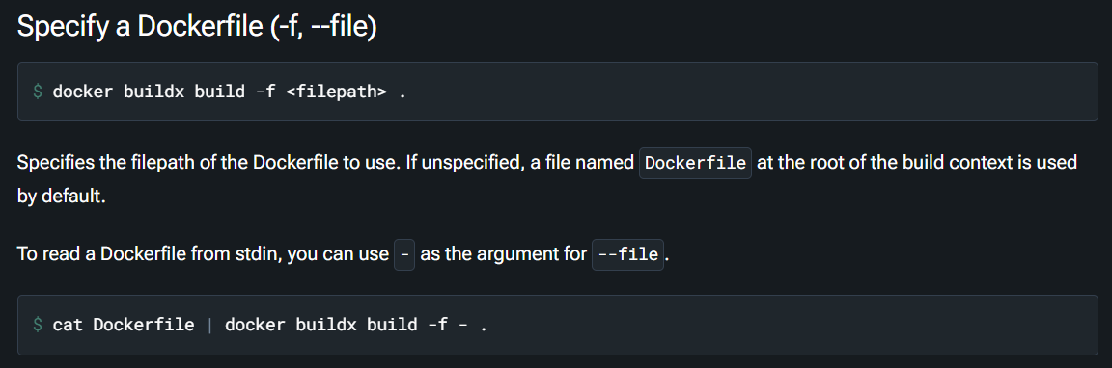

Slide 10
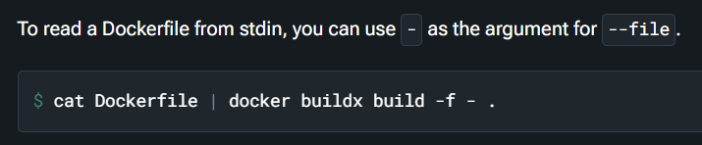
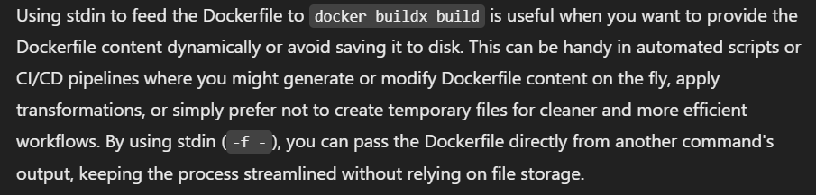
Why Use stdin?

Slide 11
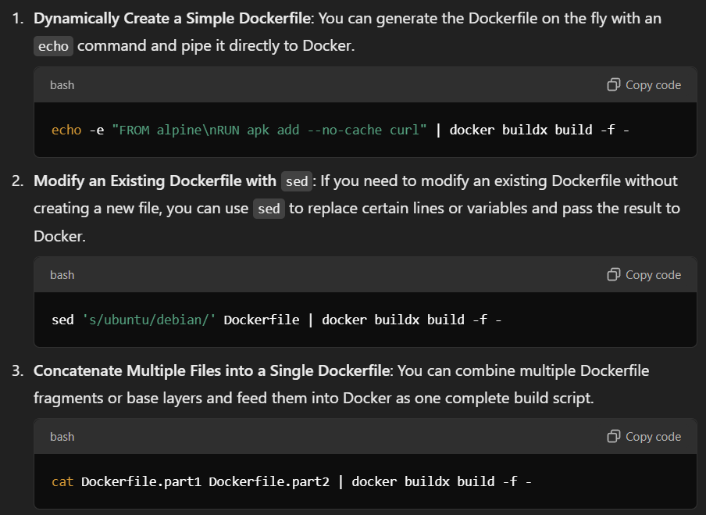
Notes:
echo -e "FROM alpine\nRUN apk add --no-cache curl" | docker buildx build -f -
sed 's/ubuntu/debian/' Dockerfile | docker buildx build -f -
cat Dockerfile.part1 Dockerfile.part2 | docker buildx build -f -

Slide 12
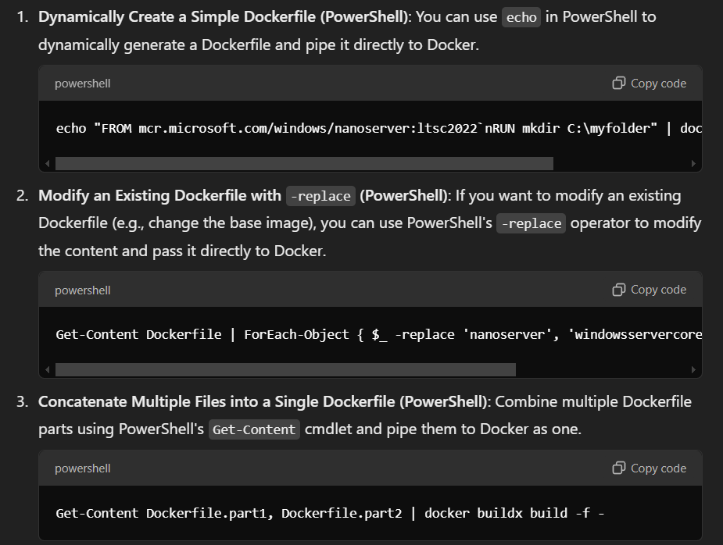
Notes:
echo "FROM mcr.microsoft.com/windows/nanoserver:ltsc2022`nRUN mkdir C:\myfolder" | docker buildx build -f -
Get-Content Dockerfile | ForEach-Object { $_ -replace 'nanoserver', 'windowsservercore' } | docker buildx build -f -
Get-Content Dockerfile.part1, Dockerfile.part2 | docker buildx build -f -

Slide 13



Notes:
https://www.youtube.com/channel/UC35ZpwldGw7ZJ5R-2sLijzw

Slide 14
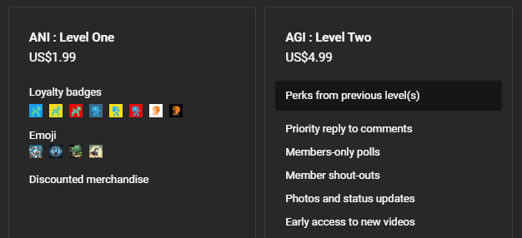

Become a Member!
Notes:
https://www.youtube.com/channel/UC35ZpwldGw7ZJ5R-2sLijzw/join

Slide 15

https://www.youtube.com/@AINewsFresh

Slide 16
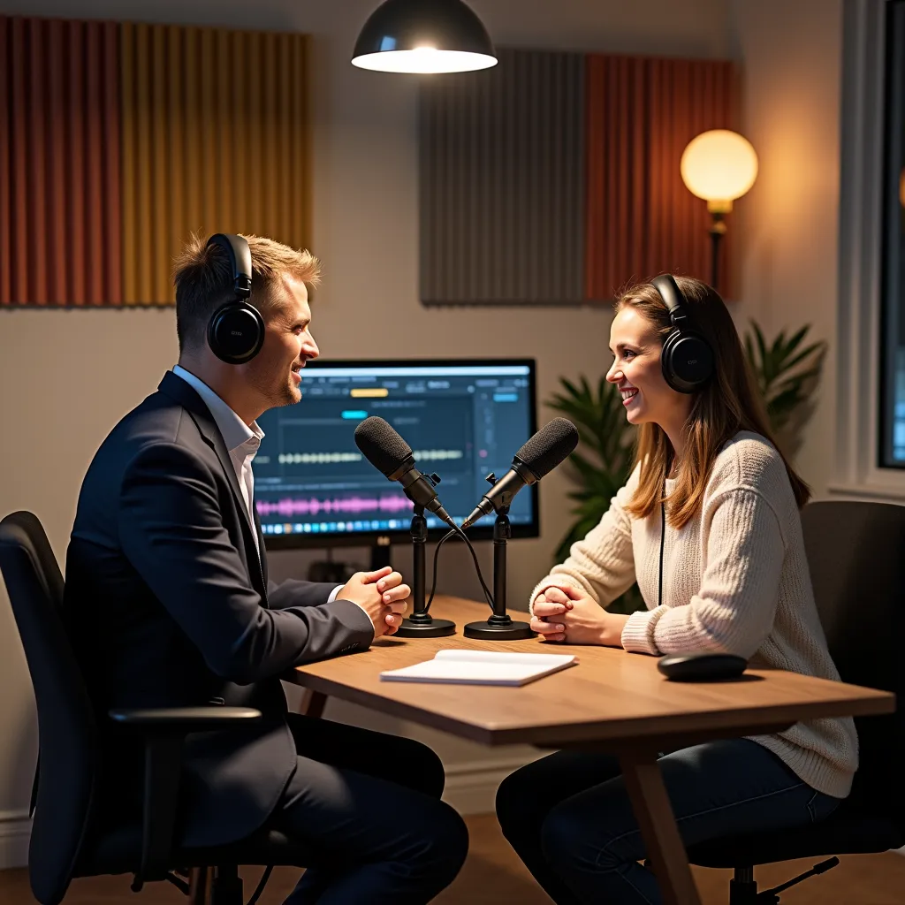

https://www.youtube.com/@DailyAINewsPodcast

Slide 17
Image Layers

Slide 18
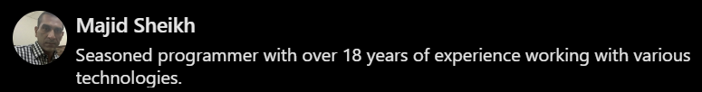
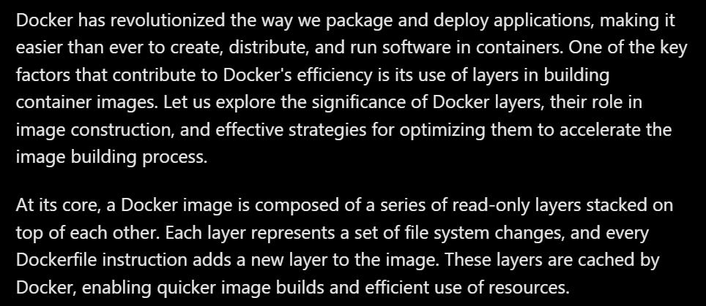
Notes:
https://www.linkedin.com/pulse/understanding-docker-layers-efficient-image-building-majid-sheikh

Slide 19
# Use the official Python image
FROM python:3
# Set the working directory
WORKDIR /usr/src/app
# Copy the requirements file
COPY requirements.txt ./
# Install dependencies
RUN pip install --no-cache-dir -r requirements.txt
# Copy the rest of the application files
COPY . .
# Create an output directory for results
RUN mkdir -p /usr/src/app/output
# Start with bash shell to allow interactive use
CMD ["/bin/bash"]
CMD ["/bin/bash"]
RUN mkdir -p /usr/src/app/output
COPY . .
RUN pip install --no-cache-dir -r requirements.txt
COPY requirements.txt ./
WORKDIR /usr/src/app
FROM python:3
Notes:
CMD ["/bin/bash"]
RUN mkdir -p /usr/src/app/output
COPY . .
RUN pip install --no-cache-dir -r requirements.txt
COPY requirements.txt ./
WORKDIR /usr/src/app
FROM python:3

Slide 20
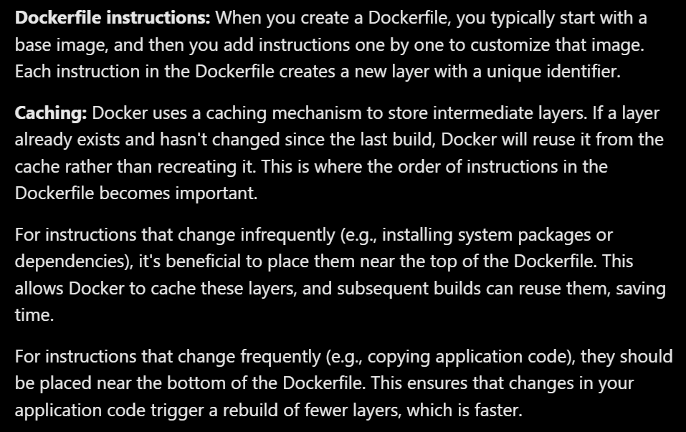
Notes:
https://www.linkedin.com/pulse/understanding-docker-layers-efficient-image-building-majid-sheikh

Slide 21
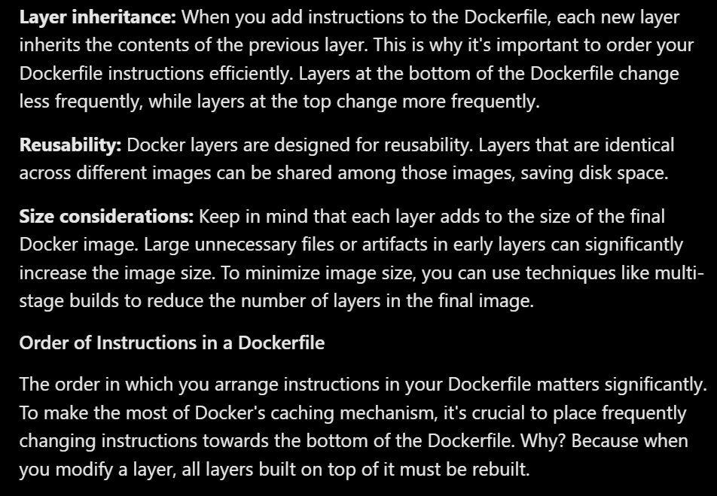
Notes:
https://www.linkedin.com/pulse/understanding-docker-layers-efficient-image-building-majid-sheikh

Slide 22
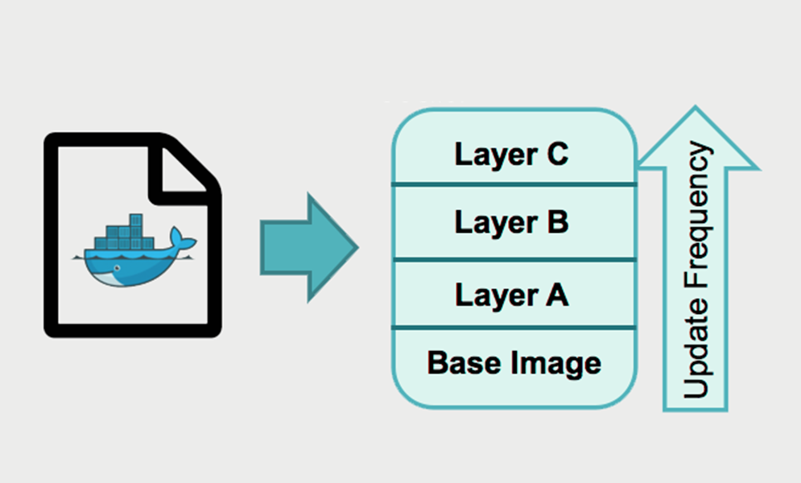
Notes:
https://www.linkedin.com/pulse/understanding-docker-layers-efficient-image-building-majid-sheikh

Slide 23
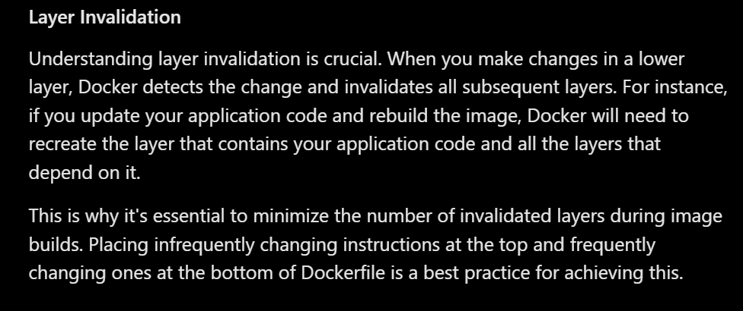
Notes:
https://www.linkedin.com/pulse/understanding-docker-layers-efficient-image-building-majid-sheikh

Slide 24
CMD ["/bin/bash"]
RUN mkdir -p /usr/src/app/output
COPY . .
RUN pip install --no-cache-dir -r requirements.txt
COPY requirements.txt ./
WORKDIR /usr/src/app
FROM python:3
Invalidates all
these layers
Changing This
on the Host
Notes:
CMD ["/bin/bash"]
RUN mkdir -p /usr/src/app/output
COPY . .
RUN pip install --no-cache-dir -r requirements.txt
COPY requirements.txt ./
WORKDIR /usr/src/app
FROM python:3

Slide 25
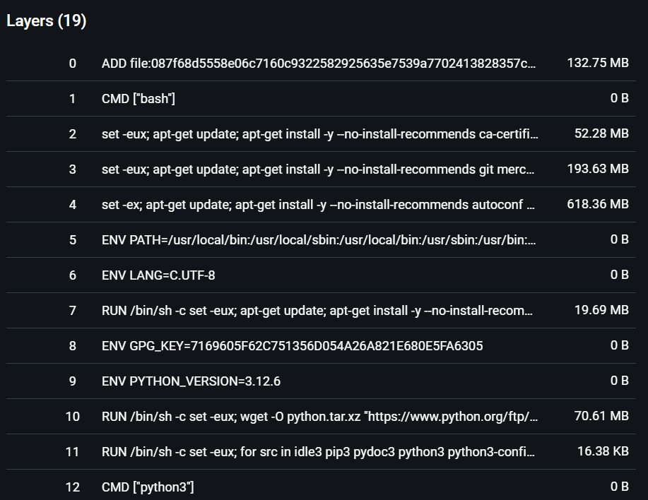
Demo: Viewing Image Layers

Slide 26


